Slide 1


Project Fahari Air
This business proposal is a crucial document that outlines the strategy and operations of the Project Fahari Air.
BUSINESS PROPOSAL

Slide 2
TABLE OF CONTENTS
01.
02.
03.
INTRODUCTION
FINDINGS
RECOMENDATIONS
Elaborate on what you want to discuss.
Qualitative representation of the Analysis.

Slide 3


INTRODUCTION
Welcome to our presentation on expanding into the aviation industry. Our objective today is to identify the safest and most suitable aircraft for our new venture. Through thorough research and analysis, we aim to provide practical insights
Join us as we navigate through the complexities of the aviation industry, assess potential risks, and highlight the best options to ensure a successful and secure entry into this exciting market.

Slide 4
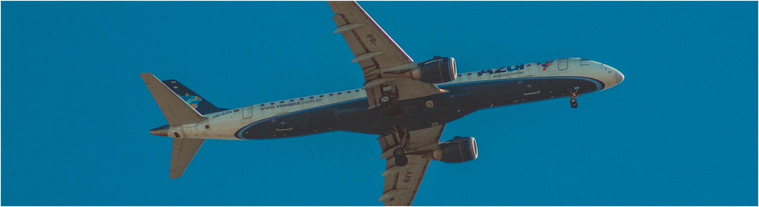
WELCOME TO PRESENTATION
I’m Spencer, and I'll be sharing with you my beautiful ideas.

Slide 5




OUR PROJECTS
FINDINGS
FLIGHT PURPOSE
ENGINE TYPE
Personal and Business were the top reasons for flights
Turbo fan and Turbo jet Engines had the most uninjured passengers
PHASE OF FLIGHT
STATE
Landing phase of flight had the most fatalities
California had the most fatalities where as New Hampshire had the least.

Slide 6
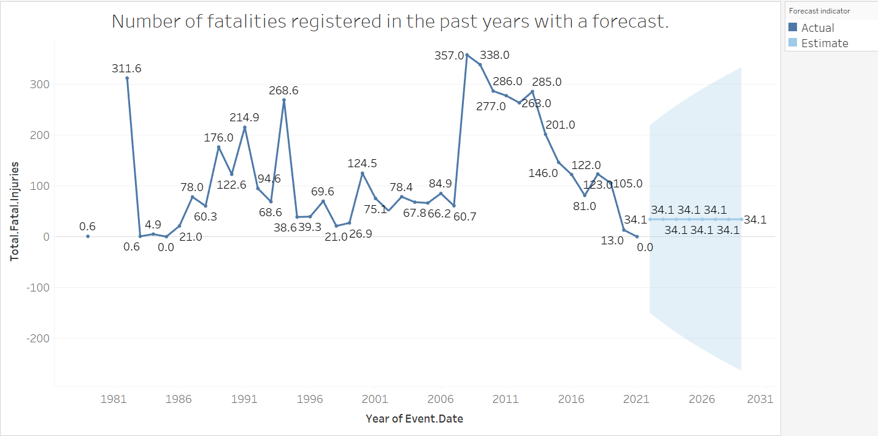
OUR PROJECTS

Slide 7
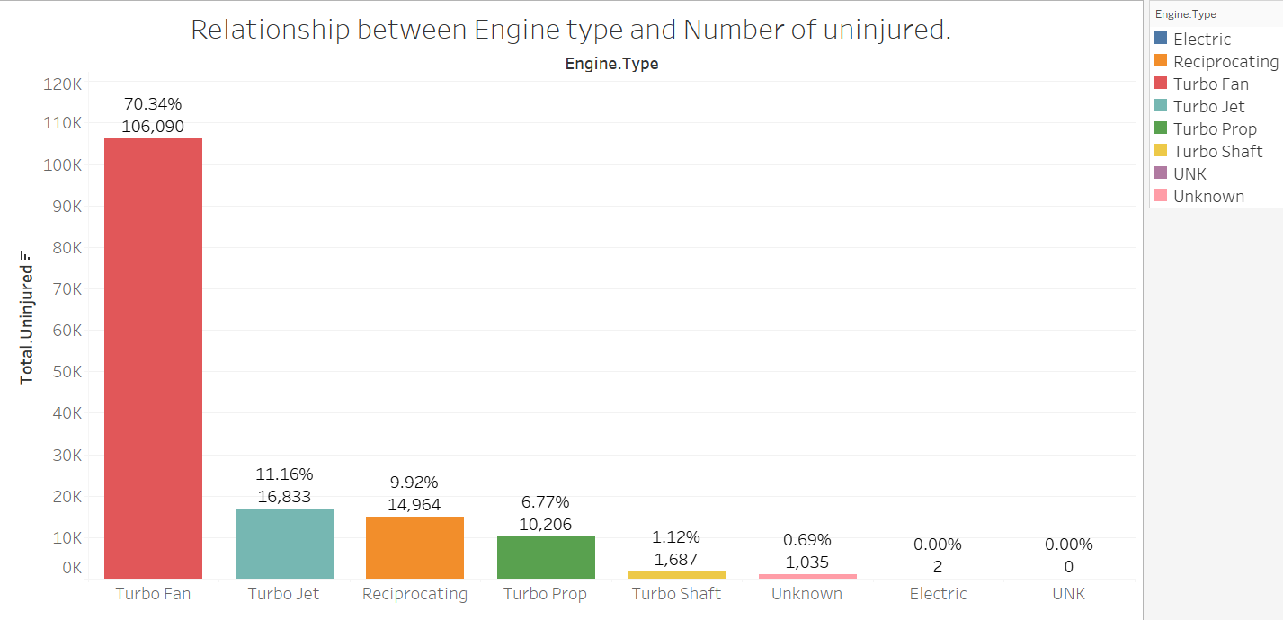
OUR PROJECTS

Slide 8
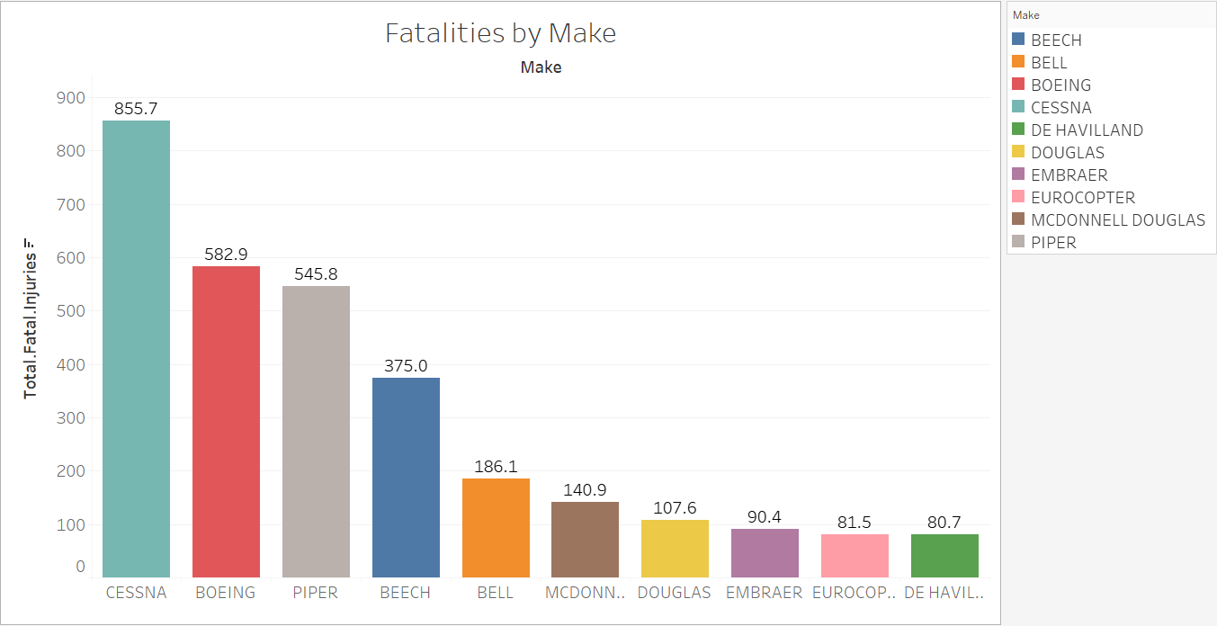
OUR PROJECTS

Slide 9


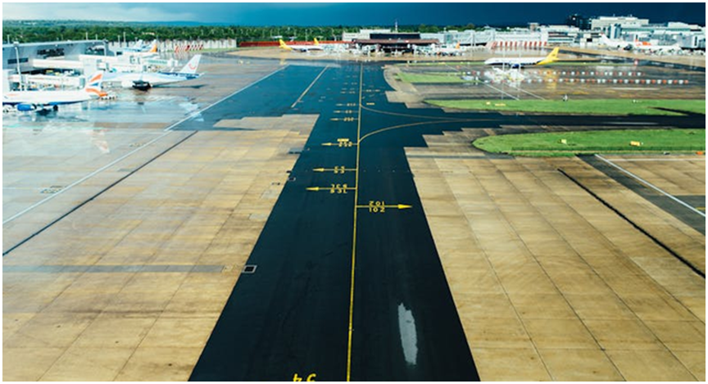


Recommendations
There is need to hire pilots who are good at landing as we saw the landing phase had the most fatalities. This would reduce the forecasted the number of fatalities.
The lowest risk plane recommended would be Boeing, Turbo fan engine type with two engines as these specific metrics from the analysis had the highest successful flights.

Slide 10
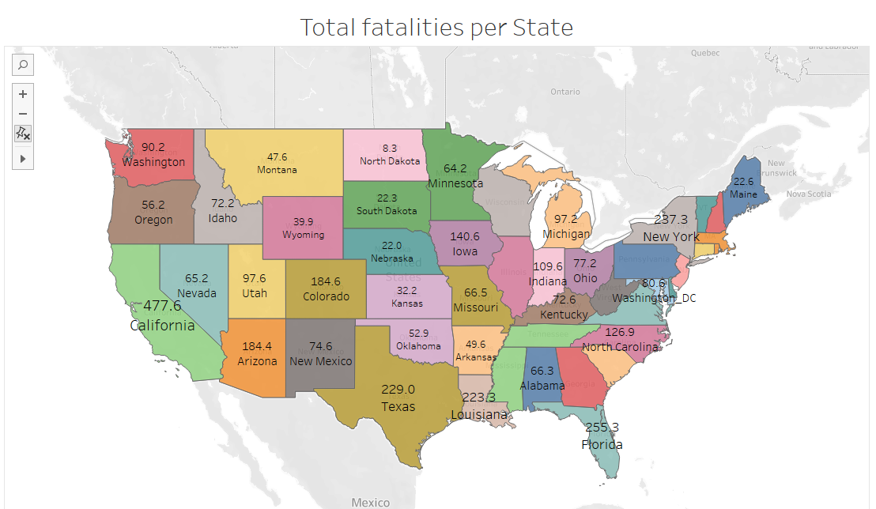
Recommendation
The whole United States presents a viable option for destination for flights therefore with this new venture the business can be rest assured of ready market.

